Slide 1
Modern Device Management; Myth vs. Reality
Steve Jesok
Jesok@mnscug.org
Ameriprise
Nash Pherson
Blog, e-mail address, title
Company

Slide 2
Steve Jesok
Nash Pherson
@SteveJesok
Twitter Handle
Design Engineer
Awards, accomplishments, etc.
Experience
Coffee
Favorite something; e.g., food

Slide 3
Presentation
Just a placeholder slide. Please use the example slides in the “Example Slides” Section.
Questions? info@mnscug.org

Slide 4
What is ‘Modern’ Device management

Slide 5
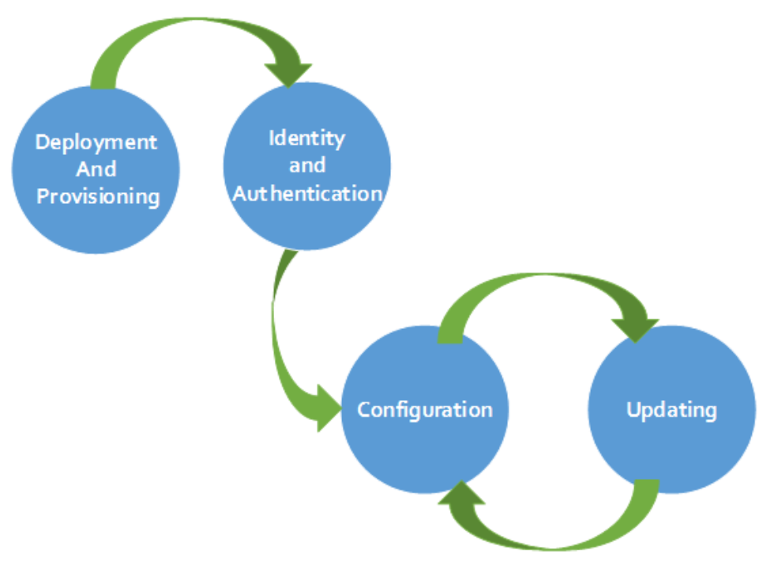
What is modern Device management?
More than just a buzz word
Starts with Windows 10
Simplifies device management
Leverages the mobile device management approach
Is really a sum of parts
Does not mean you no longer need Configuration Manager.

Slide 6
Components of Modern Device Management
Deployment and Provisioning: Delivering a device to a user and providing them what they need. What this means is “management out of the box”.
Windows Imaging and Configuration Designer
Identity and Authentication
Azure AD Join, Conditional Access
Configuration & Updating
MDM Policies, Windows Update for Business, telemetry data, etc
Notes:
Deployment and Provisioning
Windows Imaging and Configuration Designer (ICD).

Slide 7
What is Your Basic Device management Strategy?
What you get OOB, a device with an OS. What do we need to add?
Provisioning
Authentication
Configuration
Business Software
Telemetry
Updates
Guidance: https://blogs.technet.microsoft.com/enterprisemobility/2016/03/23/the-path-to-modernizing-windows-management/

Slide 8
The first baby steps
Setup a test Intune tenant
Understand the policy options and what you need.
Provisioning packages
Windows Updates for Business

Slide 9
Provisioning/Imaging

Slide 10
Windows Imaging and Configuration Designer
Can be leveraged for…
Simple provisioning: use built in options to create and deploy a configuration.
Advanced provisioning: Deploy certificates, classic win32 apps, and Universal Windows Platform (UWP) apps.
Mobile device enrollment into management: Enabled admins to apply a standard configuration to a Windows mobile devices by levering a tethered or SD deployment.
Configuration Manager and Microsoft Intune hybrid. (certificate enrollment)
Airwatch
MobileIron

Slide 11
Level Set - Configuration Service Providers (CSP)
Now we have Configuration Service Providers (CSP)
A client side interface for configuration. Works similarly to the Group Policy client side extensions as it provides a means to get (most) and set settings for a given feature.
Provides access to specific settings.
Uses SyncML (Synchronization Markup Language).
WMI-to-CSP Bridge: Allows script to get/set CSP settings.
More Information: https://msdn.microsoft.com/windows/hardware/commercialize/customize/mdm/policy-configuration-service-provider

Slide 12
Demo: ICD
Notes:
Sample provisioning package
Basic- Create user account and background
Adv: install and app

Slide 13
Configuration

Slide 14
Group vs mdm policy
System admins have historically leveraged Group Policy.
Set it and forget.
Always works, right?
Now we have Configuration Service Providers (CSP’s)
A client side interface for configuration. Works similarly to the Group Policy client side extensions as it provides a means to get and set settings for a given feature.
Provides access to specific settings.
Uses SyncML (Synchronization Markup Language)

Slide 15
Group Policy and MDM Side by Side
Group Policy
MDM Policy
Every 90 Minutes (random offset of 30)
Gpupdate /force
Microsoft-Windows-GroupPolicy/Operational
Gpresult.exe
Every 3 min after enrollment, then every 8 hours.
Settings – Access Work or School – Info – Sync
Microsoft-Windows-DeviceManagment-Diagnostics-Provider/Admin
.\mdmReportGenerator.ps1 MDMDiagReport.xml MDMDiagReport.html

Slide 16
Demo: CSP Under the Hood
Notes:
How the WMI bridge works
How to access data

Slide 17
Demo: Is GPO really working?

Slide 18
Windows 10 MDM Policies
Custom policy:
Use the Microsoft Intune custom policy for Windows 10 and Windows 10 Mobile to deploy OMA-URI settings that can be used to control features on devices.
General configuration policy:
Use this policy type when you want to select settings from the built-in list that's supplied with Microsoft Intune.

Slide 19
Demo: Is MDM really working?

Slide 20
Application Delivery
Depending on your requirements you may have choices…
Configuration Manager
Intune
Windows ICD
Windows Store for Business

Slide 21
MMAT – What is it?
Maps Group Policy settings to MDM policies
Identified the MDM policies which map to your existing GPO settings for a given system

Slide 22
Demo: MMAT

Slide 23
Updates and the Cadence

Slide 24
Rings, biannual updates, and things
Windows 10 update rings
Office 365 Pro Plus bi-annual updates
https://support.office.com/en-us/article/Overview-of-the-upcoming-changes-to-Office-365-ProPlus-update-management-78b33779-9356-4cdf-9d2c-08350ef05cca?ui=en-US&rs=en-US&ad=US
Windows Update for Business

Slide 25
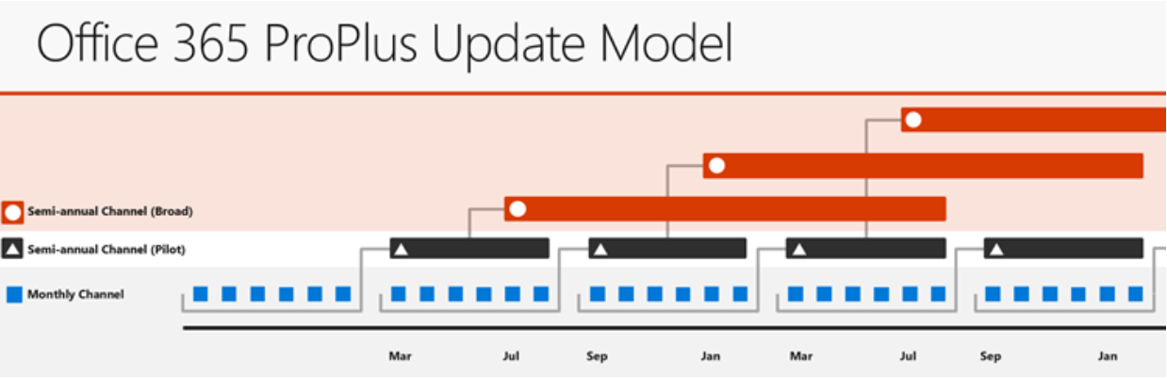
The Cadence
Is possibly starting to settle in with the recent changes announced with Office Pro Plus…

Slide 26
Rings, biannual updates, and things
Windows 10 update rings
Office 365 Pro Plus bi-annual updates
Monthly security updates
Windows Update for Business

Slide 27
Windows Store for Business

Slide 28
Telemetry
Understand the impact of change, fact based decisioning.
Visibility into problems areas
Windows Update Readiness
Office Telemetry Toolkit
Why wouldn't you want free intelligence?

Slide 29
Microsoft Graph Api
The web service to access cloud resources.
Intune
Office 365
AAD
https://developer.microsoft.com/en-us/graph
PS examples: https://github.com/microsoftgraph/powershell-intune-samples

Slide 30
Demo: MS Graph

Slide 31
Remember Modern Device management…
Does not happen over night!
Take small steps towards it
Leverage what you already have
Don’t‘ for get the requirements

Slide 33


Slide 34
Links and things
Win 10 Rings: https://docs.microsoft.com/en-us/windows/deployment/update/waas-deployment-rings-windows-10-updates
Office Update Cadence: https://support.office.com/en-us/article/Overview-of-the-upcoming-changes-to-Office-365-ProPlus-update-management-78b33779-9356-4cdf-9d2c-08350ef05cca?ui=en-US&rs=en-US&ad=US

Slide 35
Section Header
This is the next section

Slide 36
Title
Line1
Bullet Level 1
Bullet Level 2
Bullet Level 3

Slide 37
Title
Code

Slide 38
Text Only with Border
Level 1
Level 2
Level 3

Slide 39
Text Only (Red)
Level 1
Level 2
Level 3

Slide 40
Title
Text 1
Level 1
Level 2
Level 3
Text 2
Level 1
Level 2
Level 3

Slide 41
Title
Section 1
Section 2
Text
Level 1
Level 2
Level 3
Text
Level 1
Level 2
Level 3

Slide 42
Demo Title

Slide 43





























Slide 44






























Slide 45




























Slide 46




























Slide 47




























Slide 48




























Slide 49




























Slide 50























Slide 51
















